Slide 1
Monitoring Solace with the ELK Toolkit
Ken Overton

Slide 2



Why NOT use ELK?
Make Solace SYSLOG events available ASAP
It is not better than commercial monitoring solutions we partner with
ITRS Geneos
RTView
Nastel
It has unknown performance characteristics at scale
Requires customization to fit any SEMP-based data

Slide 3



So why ELK? Customers don’t always make good choices
We need solutions for them that stave off disaster with minimal effort

Slide 4
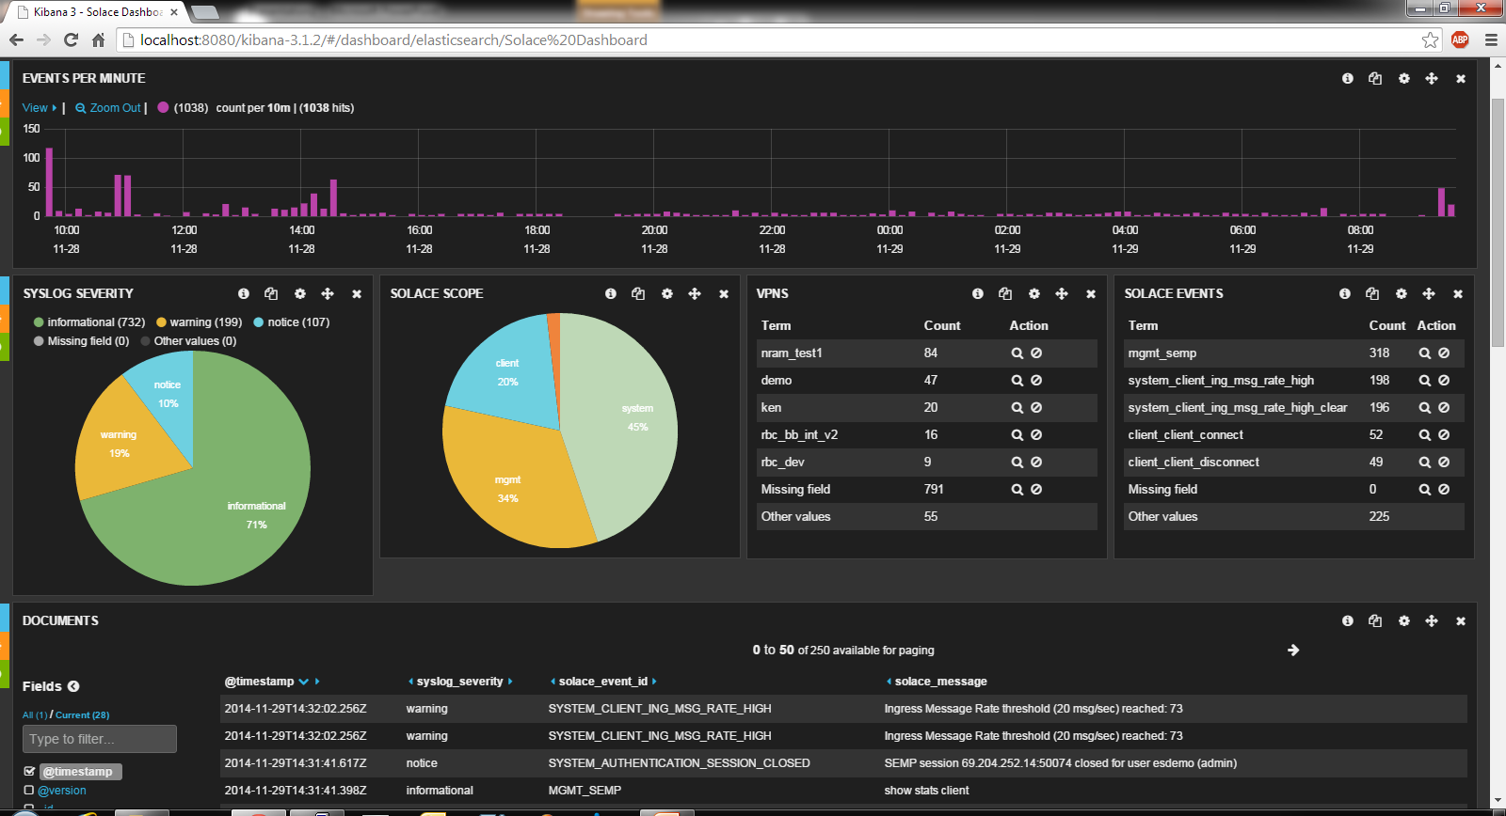
The Point: Get Something Useful on Day One

Slide 5



Cool, so what is “ELK”?
Elasticsearch
Logstash
Kibana
Enterprise-scale search engine built on top of Lucene
Event and Log management tool
Web-based UI for Elasticsearch indices

Slide 6

No really, what IS ELK?
Normalization
Indexing/Retrieval
Presentation
SYSLOG
JSON
JSON
demo-tr> enable
demo-tr# configure
(config)# create syslog jimmy
(config)# host 192.168.13.82 tcp
(config)# facility event
(config)# facility system
(config)# facility command
Listens to port 514 for SYSLOG events
Parses inbound data into JSON records
Publishes JSON records to Elasticsearch
Receives data from Logstash via HTTP PUT/POST operations and indexes it
Returns search results to Kibana based on dynamic queries
Web-based UI for presenting Elasticsearch queries
Customizable Dashboard layouts with sample Logstash dashboard

Slide 7
Initial Setup (Solace)
Add a Solace syslog forwarder to each appliance pointing to the IP-address of your Logstash instance listening on port 514
Configure all facilities you want to monitor (do at least system and event)
demo-tr> enable
demo-tr# configure
(config)# create syslog <name>
(config)# host <logstash-IP> tcp
(config)# facility event
(config)# facility system
(config)# facility command

Slide 8
Initial Setup (MINIMAL)
Logstash:
Copy solace syslog definitions into the patterns folder
Copy config file using syslog definitions anywhere (I make a config folder for it)
Elasticsearch:
Allow cross-site scripting in the elasticsearch.yml file:
http.cors.allow-origin: "/.*/“ http.cors.enabled: true
Kibana:
Untar Kibana under your HTTP document root directory (i.e., /var/www/html/)
Edit config.js to point to your elasticsearch port:
elasticsearch: "http://127.0.0.1:9200",

Slide 9
Logstash configuration details
Configuration Sections:
input { tcp { port => "514“ type => syslog } }
filter { ... }
output { elasticsearch { host => localhost } }
Filter section uses regex patterns from patterns/solace-syslog to pull out solace fields filter { if [type] == "syslog" { if [message] =~ /: CLI|: SEMP|: SHELL/ { grok { match => { "message" => "%{SOLACE_REMOTE_COMMAND}" } match => { "message" => "%{SOLACE_SHELL_COMMAND}" } } } else if [message] =~ / CLIENT:| VPN:| SYSTEM:/ { grok { match => { "message" => "%{SOLACE_EVENT_LOG}“ } } syslog_pri {} } }

Slide 10
GROK patterns give Elasticsearch more fields for filtering
Record before Solace patterns:
{ "message” : "<142>Nov 20 13:07:25 demo-tr admin[4970]: SEMP/mgmt 38.108.247.86 admin 13:07:25 13:07:25 ok show message-spool vpn-name=AIM", "@version” : "1", "@timestamp” : "2014-11-20T19:13:06.469Z”, "type":"syslog” }
Record after Solace patterns: { "@version” : "1", "@timestamp” : "2014-11-20T19:13:06.469Z”, "type” : "syslog”, "host” : "192.168.130.60:35157", "syslog_timestamp" : "Nov 20 13:07:25", "syslog_hostname" : "demo-tr", "syslog_userid" : "admin", "syslog_pid" : "4970", "solace_client_address" : "38.108.247.86", "solace_cmd_source" : "SEMP", "solace_cmd_start_time" : "13:07:25", "solace_cmd_end_time" : "13:07:25", "solace_cmd_status" : "ok", "solace_message" : "show message-vpn vpn-name=AIM", "solace_event_id" : "MGMT_SEMP", "solace_scope" : "MGMT", "syslog_severity_code" : 6, "syslog_facility_code" : 17, "syslog_facility" : "local1", "syslog_severity" : "informational” }

Slide 11
Starting It Up
How do I know it’s working?
Check ElasticSearch server for data: http://host:9200/_search?pretty
Check Logstash for failed events: cat <logstash>/failed_syslog_events.log
Browse to Kibana site http://webhost/kibana-3.1.2/
Start ElasticSearch w/CORS turned on
[as root] Start logstash w/Solace-specific configuration
Grok additions
Output to ElasticSearch
Start webserver
Order of initialization doesn’t matter

Slide 12
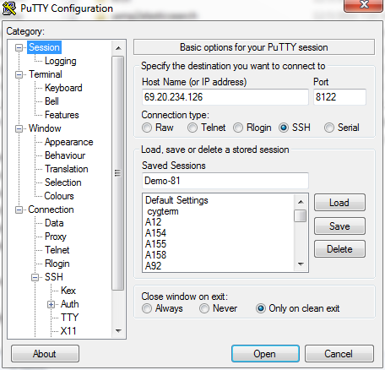
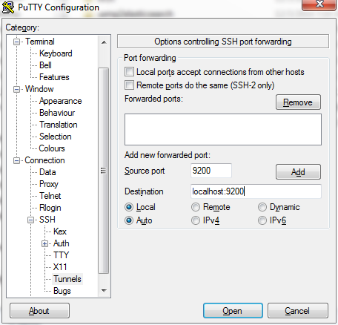
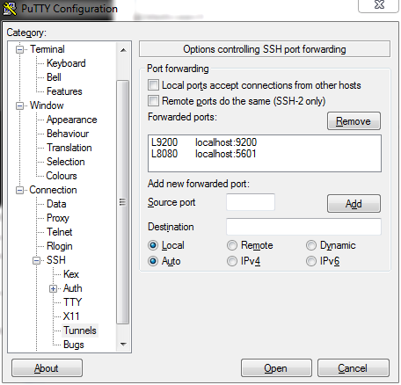
SSH Tunneling Demo Network to Your Desktop
Start with a standard SSH session to a remote server
Tunnel a port from the remote server to your desktop host via SSH, and expose it locally
Example tunneling ports 9200 and 5601 from the remote server to localhost ports 9200 and 8080

Slide 13
Kibana Demo

Slide 14
Integrating SEMP Queries
ElasticSearch Operations:
Check for an index:
curl –xHEAD host:9200/<index>
Create an index:
curl –XPUT host:9200/<index>
Add an item to an index:
curl –XPOST host:9200/<index>/<type>
Integrate with ElasticSearch, bypassing Logstash
Create stats indices separately from syslog indices
Follow the same model of one index per day, auto-generating new index upon date rollover
Create your own type field for stats
Convert XML to JSON objects
JSON in Java library by json.org is ideal for this
All the work can be done thru REST operations
HEAD, GET, PUT, POST

Slide 15
Elasticsearch details
Built on core Lucene indexing/retrieval capabilities
REST API makes all data and mgmt tasks usable via HTTP GET, PUT and POST operations
Natively reads JSON data structures
Logstash creates separate index per day
REST API means everything can be prototyped with curl, e.g.,
-Add an item with specific ID: curl -XPUT "localhost:9200/$index/$type/$id" -d "$data”
-Add an item to an index without ID: curl –XPOST "localhost:9200/$index/$type/" -d "$data”
-List an item by ID: curl –XGET "localhost:9200/$index/$type/$id”
-List all indices: curl 'localhost:9200/_cat/indices'

Slide 16
Next Steps …
Achievable with more work:
Send email alerts based upon trigger event
Integrating all SEMP query data
Traffic-light style signals for key metrics
Better look to commercial solutions instead:
Enterprise-level visualizations of application health
Custom UI visualizations:
Heatmaps
Performance graphing
Some visualizations combining SYSLOG and SEMP data

